Slide 1
6
C Arrays

Slide 2
OBJECTIVES
In this chapter you will learn:
To pass arrays to functions.
To use arrays to store, sort and search lists of values.

Slide 3
6.5 Passing Arrays to Functions
6.6 Sorting Arrays
6.7 Case Study: Computing Mean, Median and Mode Using Arrays
6.8 Searching Arrays

Slide 4
6.5 Passing Arrays to Functions
Passing arrays
  To pass an array argument to a function, specify the name of the array without any brackets
      int myArray[ 24 ];
      myFunction( myArray, 24 );
    Array size usually passed to function
  Arrays passed call-by-reference
  Name of array is address of first element
  Function knows where the array is stored
    Modifies original memory locations
Passing array elements
  Passed by call-by-value
  Pass subscripted name (i.e., myArray[ 3 ]) to function

Slide 5
6.5 Passing Arrays to Functions
Function prototype
    void modifyArray( int b[], int arraySize );
  Parameter names optional in prototype
    int b[] could be written int []
    int arraySize could be simply int

Slide 6
Performance Tip 6.3
Passing arrays by reference makes sense for performance reasons. If arrays were passed by value, a copy of each element would be passed. For large, frequently passed arrays, this would be time consuming and would consume considerable storage for the copies of the arrays.

Slide 7
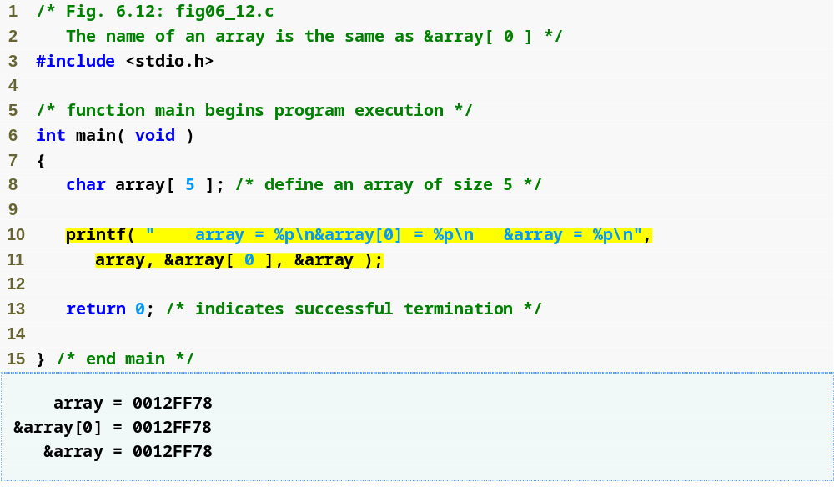
Outline
fig06_12.c

Slide 8
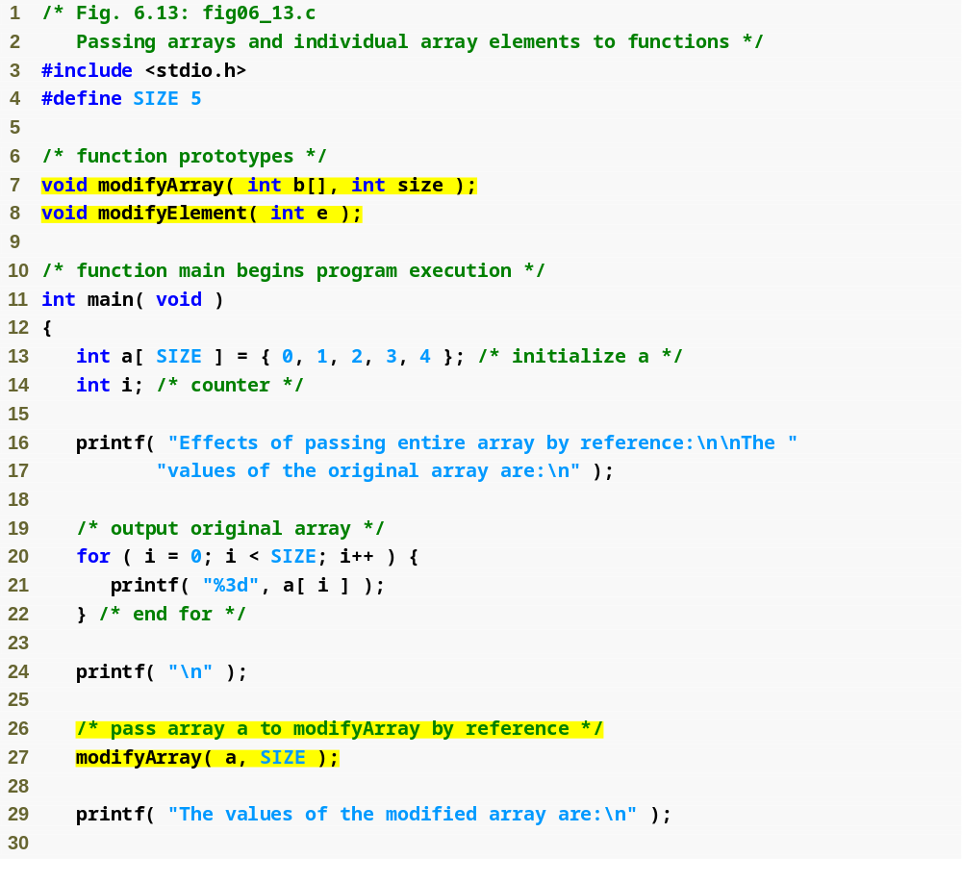
Outline
Function prototype indicates function will take an array
fig06_13.c
(1 of 3 )
Array a is passed to modifyArray by passing only its name

Slide 9
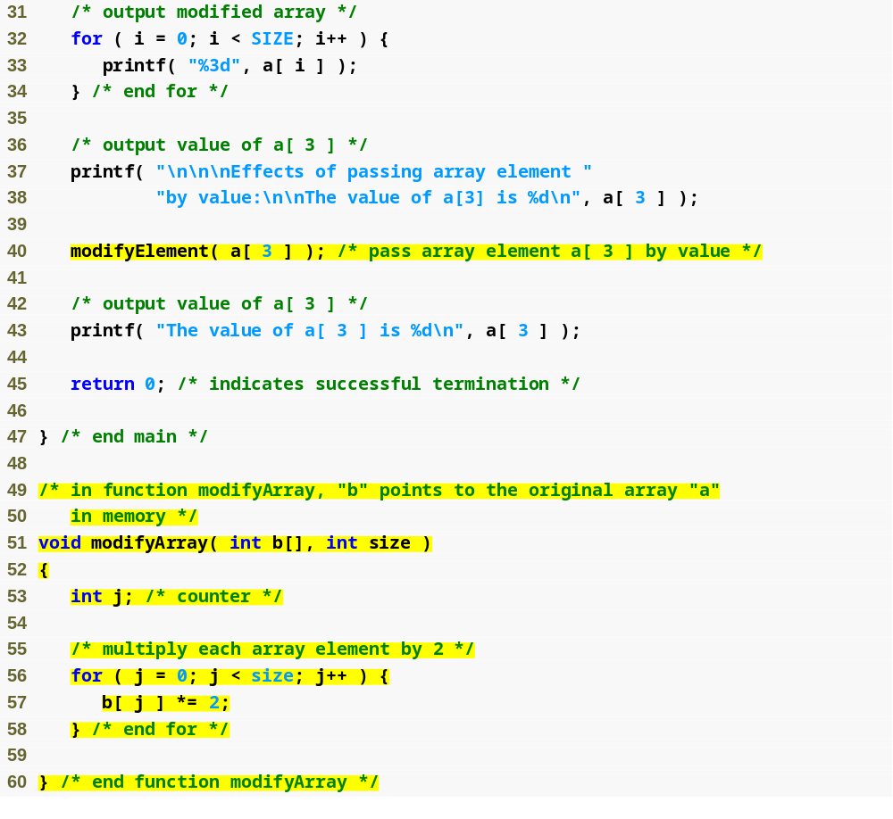
Outline
fig06_13.c
(2 of 3 )
Array element is passed to modifyElement by passing a[ 3 ]

Slide 10
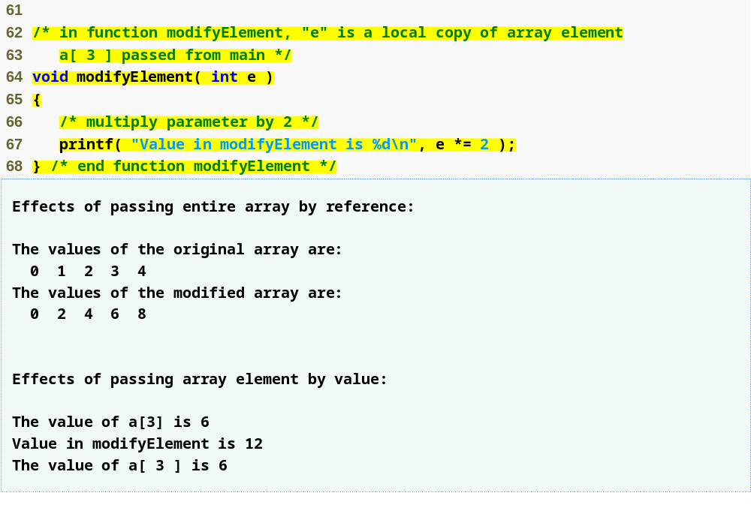
Outline
fig06_13.c
(3 of 3 )

Slide 11
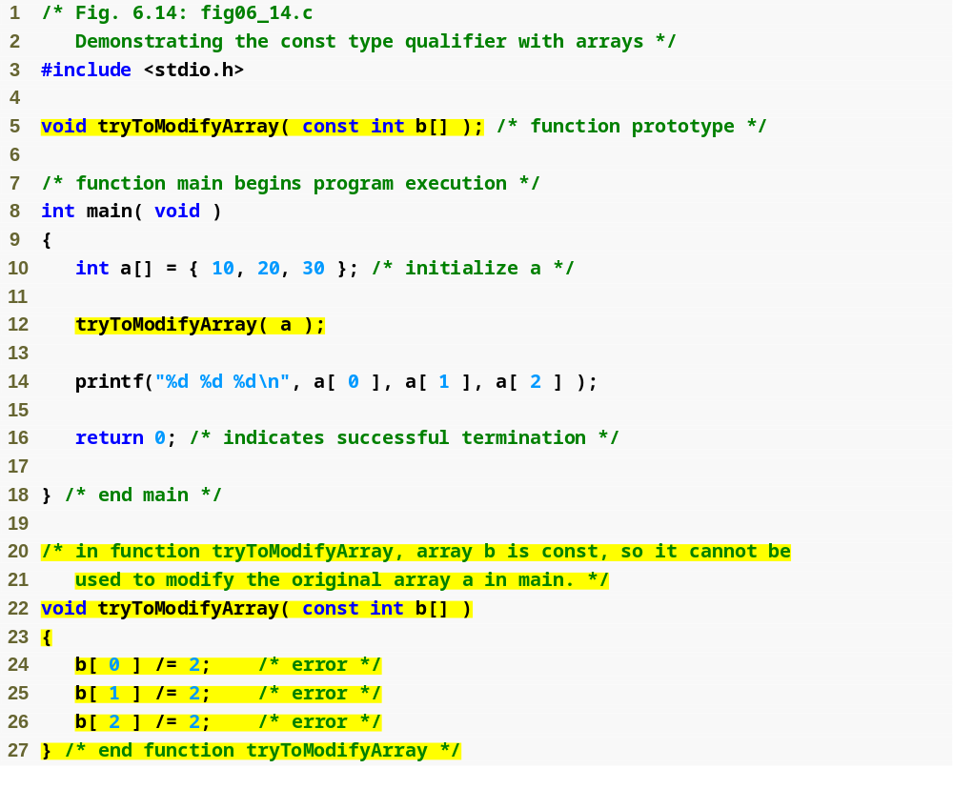
Outline
fig06_14.c
(1 of 2 )
const qualifier tells compiler that array cannot be changed
Any attempts to modify the array will result in errors

Slide 12
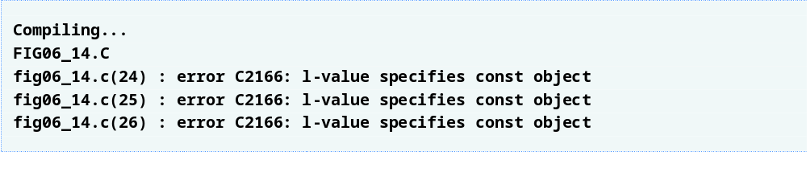
Outline
fig06_14.c
(2 of 2 )

Slide 13
Software Engineering Observation 6.3
The const type qualifier can be applied to an array parameter in a function definition to prevent the original array from being modified in the function body. This is another example of the principle of least privilege. Functions should not be given the capability to modify an array unless it is absolutely necessary.

Slide 14
6.6 Sorting Arrays
Sorting data
  Important computing application
  Virtually every organization must sort some data
Bubble sort (sinking sort)
  Several passes through the array
  Successive pairs of elements are compared
    If increasing order (or identical ), no change
    If decreasing order, elements exchanged
  Repeat
Example:
  original: 3 4 2 6 7
  pass 1: 3 2 4 6 7
  pass 2: 2 3 4 6 7
  Small elements "bubble" to the top

Slide 15
Performance Tip 6.4
Often, the simplest algorithms perform poorly. Their virtue is that they are easy to write, test and debug. However, more complex algorithms are often needed to realize maximum performance.

Slide 16
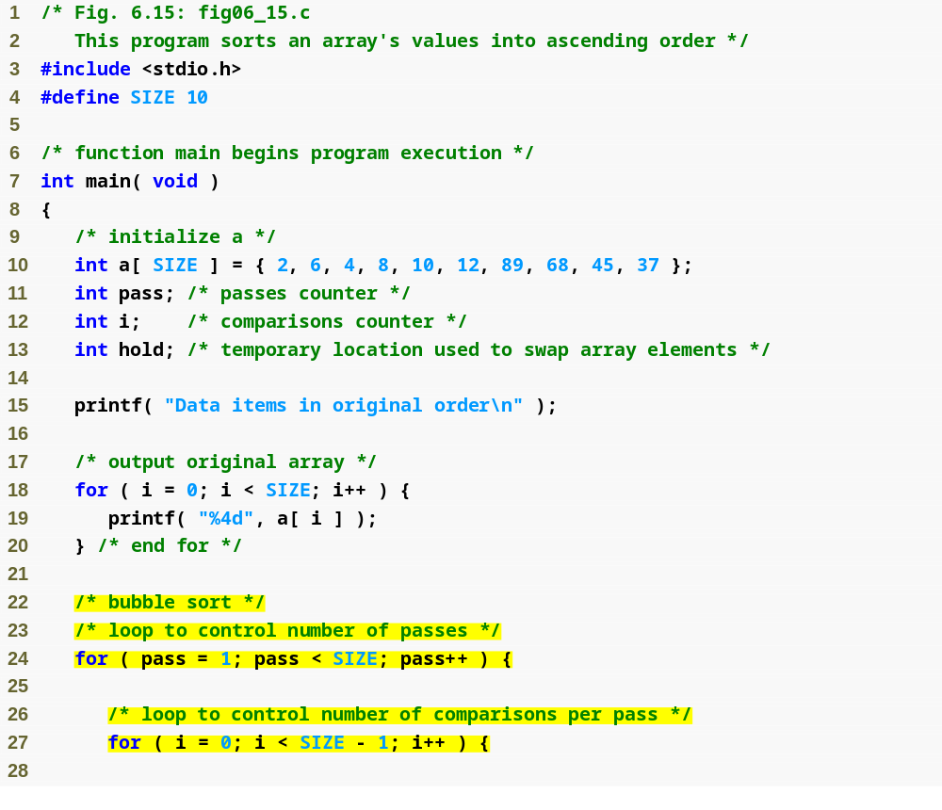
Outline
fig06_15.c
(1 of 2 )

Slide 17
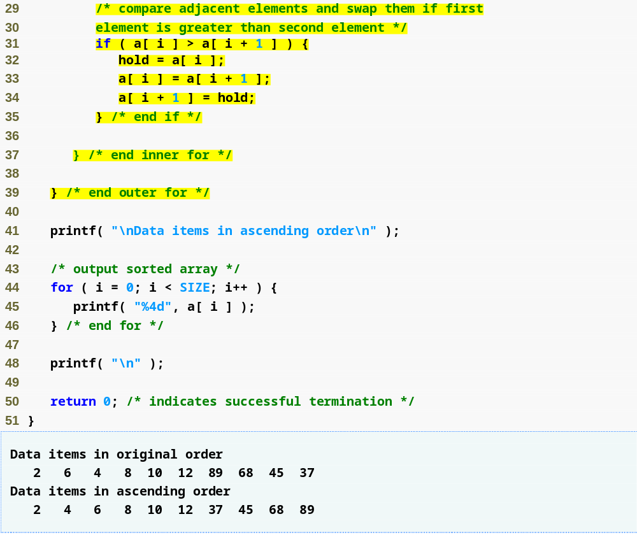
Outline
If any two array elements are out of order, the function swaps them
fig06_15.c
(2 of 2 )

Slide 18
6.7 Case Study: Computing Mean, Median and Mode Using Arrays
Mean – average
Median – number in middle of sorted list
  1, 2, 3, 4, 5
  3 is the median
Mode – number that occurs most often
  1, 1, 1, 2, 3, 3, 4, 5
  1 is the mode

Slide 19
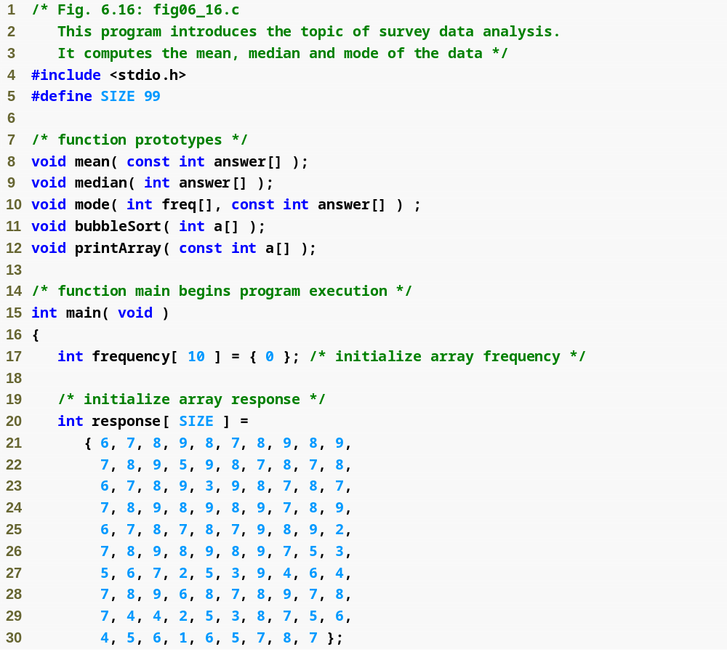
Outline
fig06_16.c
(1 of 6 )

Slide 20
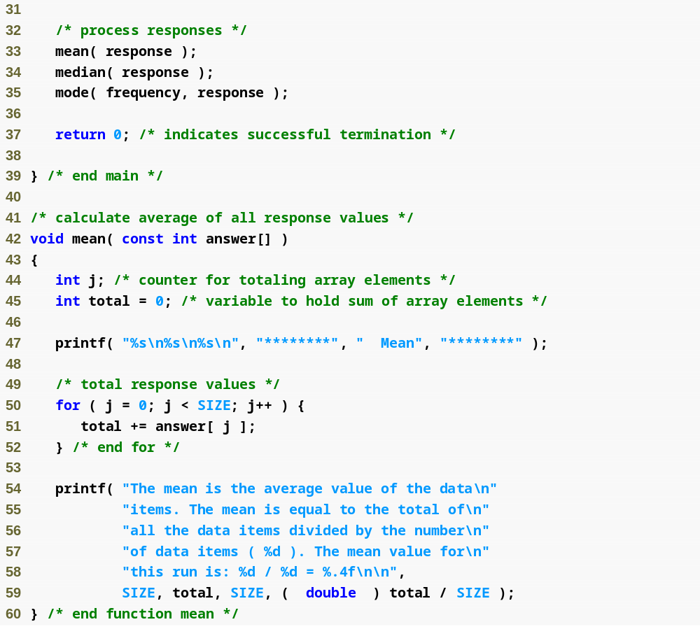
Outline
fig06_16.c
(2 of 6 )

Slide 21
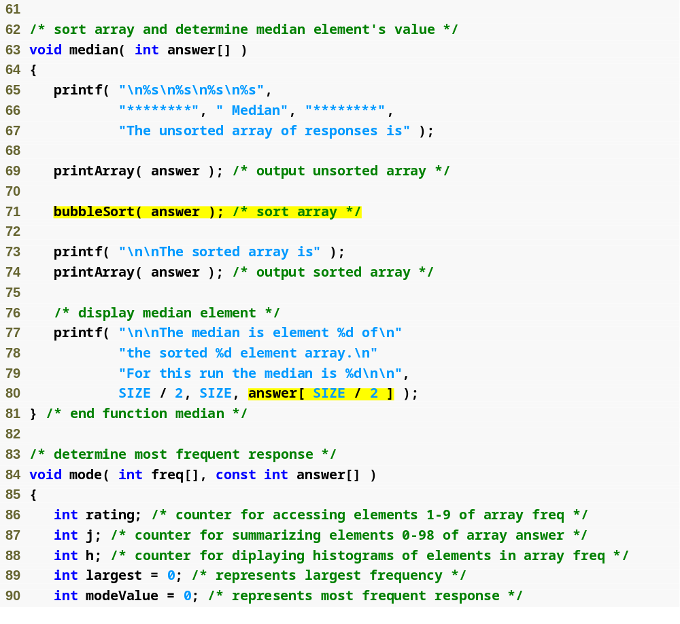
Outline
fig06_16.c
(3 of 6 )
Once the array is sorted, the median will be the value of the middle element

Slide 22
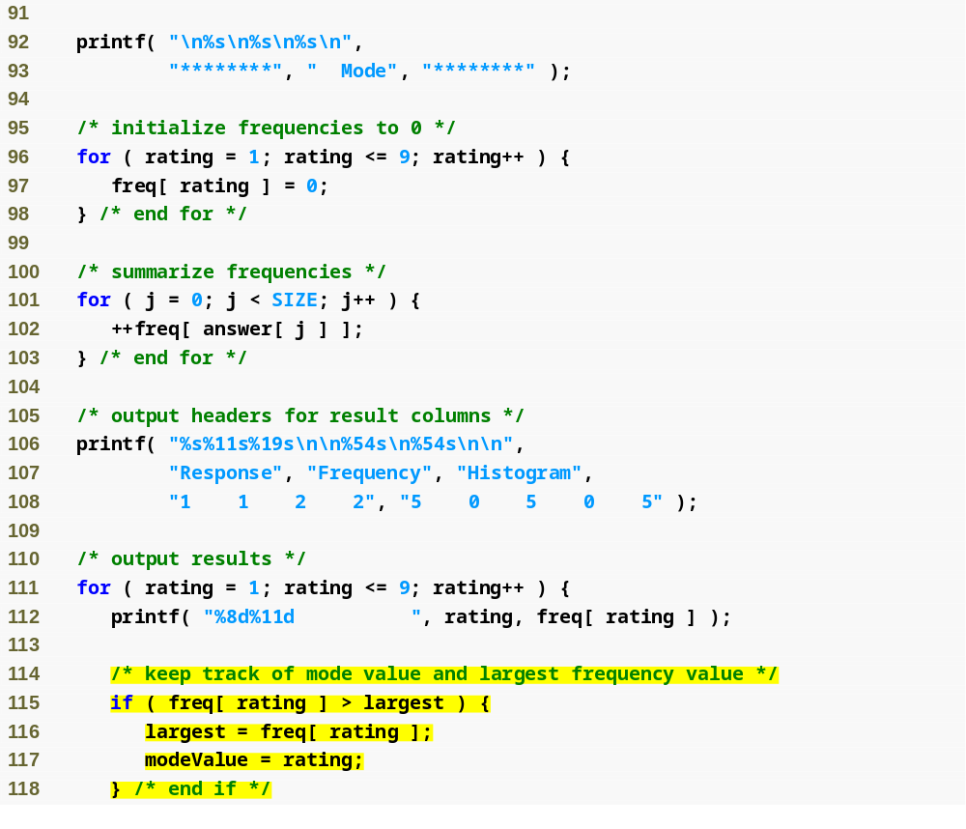
Outline
fig06_16.c
(4 of 6 )

Slide 23
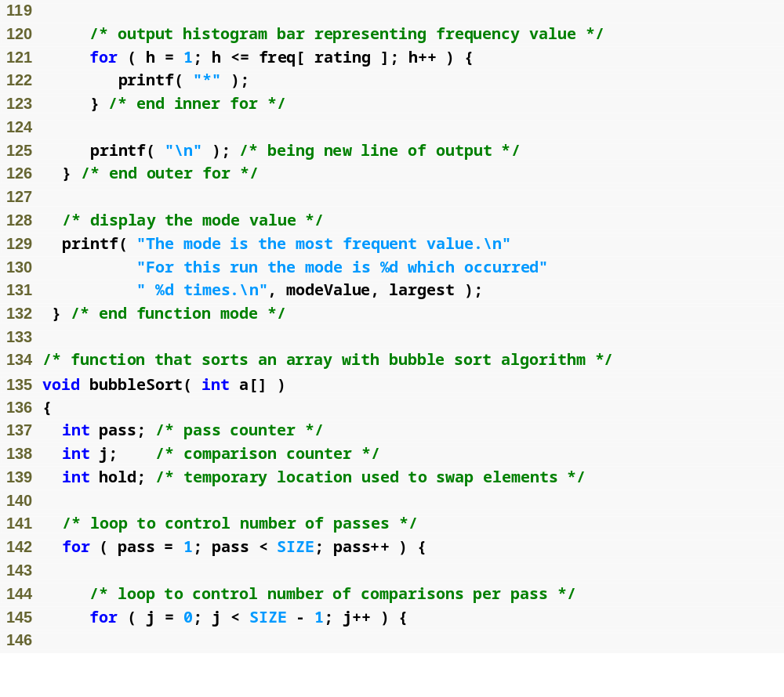
Outline
fig06_16.c
(5 of 6 )

Slide 24
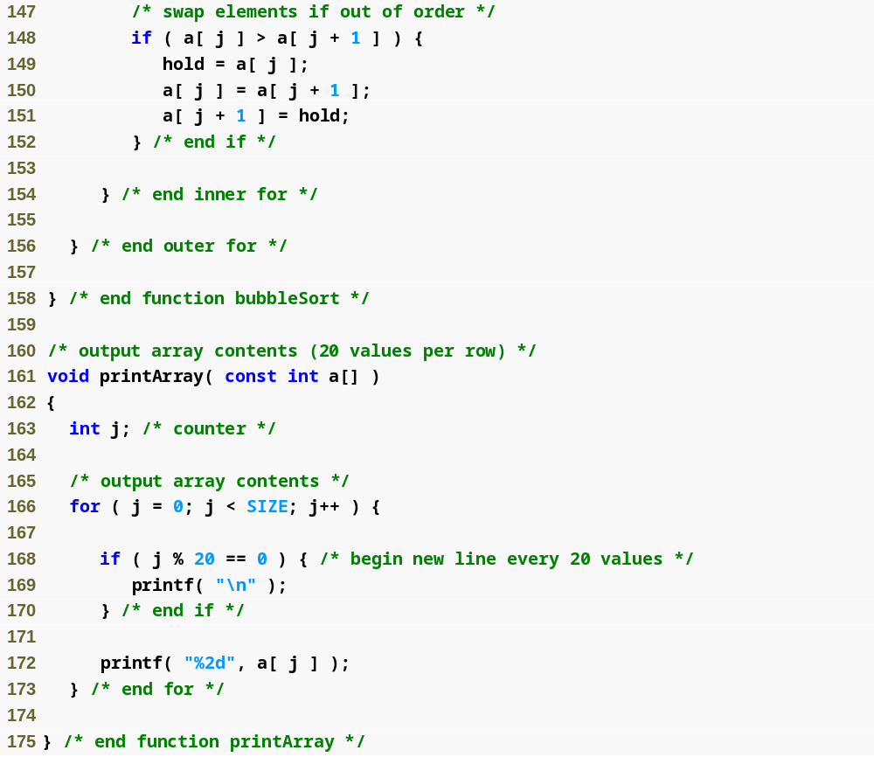
Outline
fig06_16.c
(6 of 6 )

Slide 25
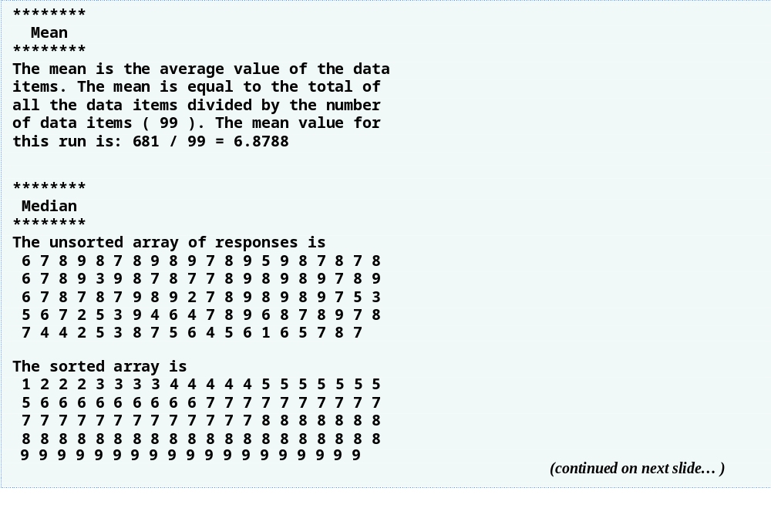
Outline
(1 of 2 )

Slide 26
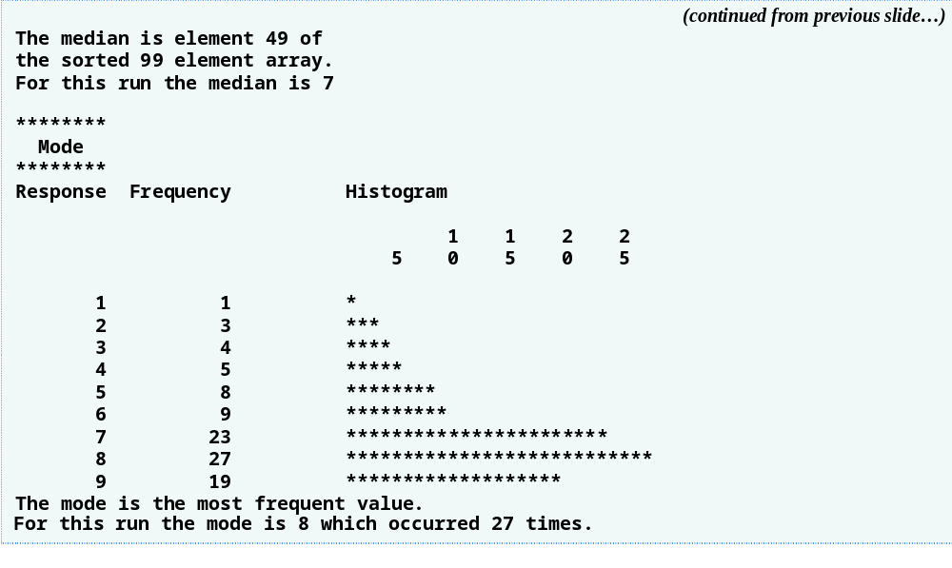
Outline
(2 of 2 )

Slide 27
6.8 Searching Arrays
Search an array for a key value
Linear search
  Simple
  Compare each element of array with key value
  Useful for small and unsorted arrays

Slide 28
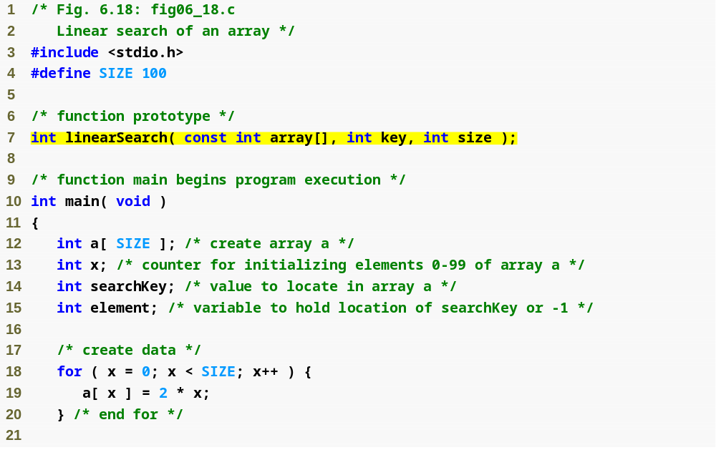
Outline
fig06_18.c
(1 of 3 )

Slide 29
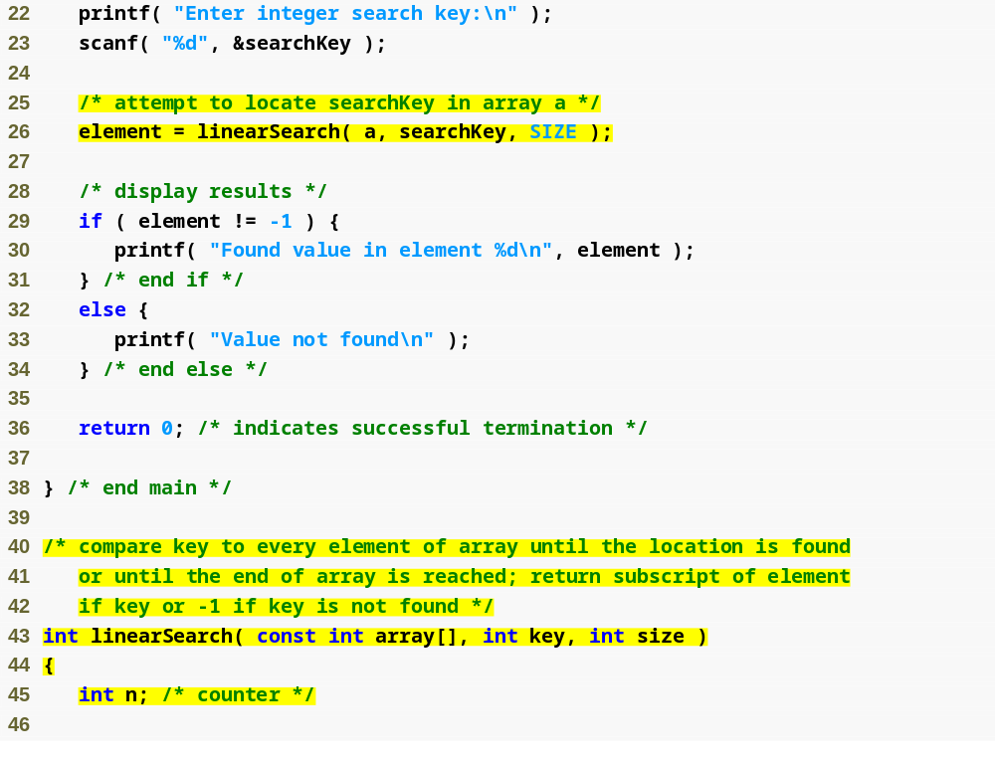
Outline
fig06_18.c
(2 of 3 )

Slide 30
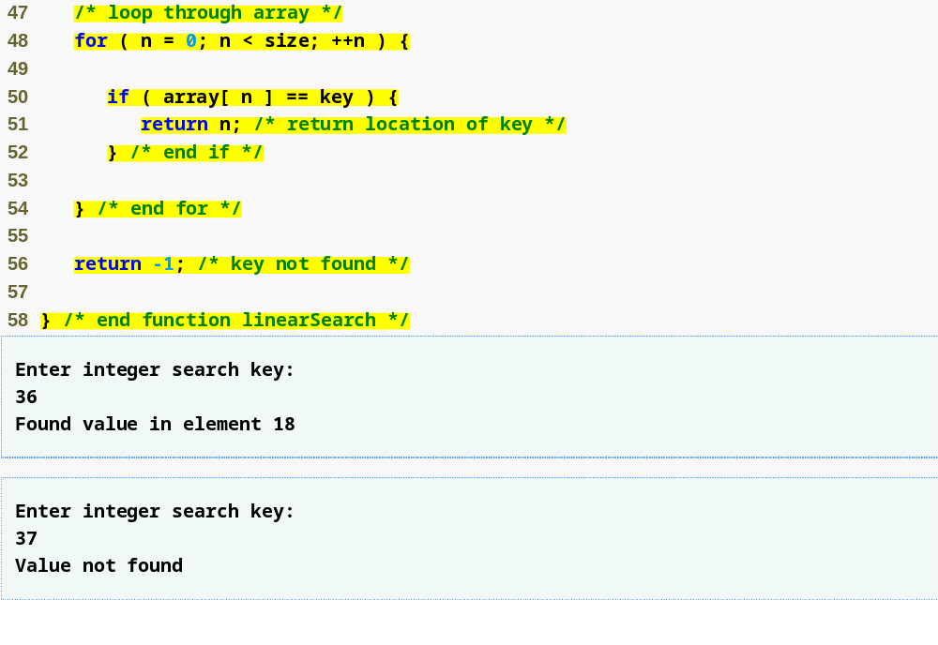
Outline
Linear search algorithm searches through every element in the array until a match is found
fig06_18.c
(3 of 3 )

Slide 31
6.8 Searching Arrays
Binary search
  For sorted arrays only
  Compares middle element with key
    If equal, match found
    If key < middle, looks in first half of array
    If key > middle, looks in last half
    Repeat
  Very fast; at most n steps, where 2^{n} > number of elements
    30 element array takes at most 5 steps
      2⁵ > 30 so at most 5 steps

Slide 32
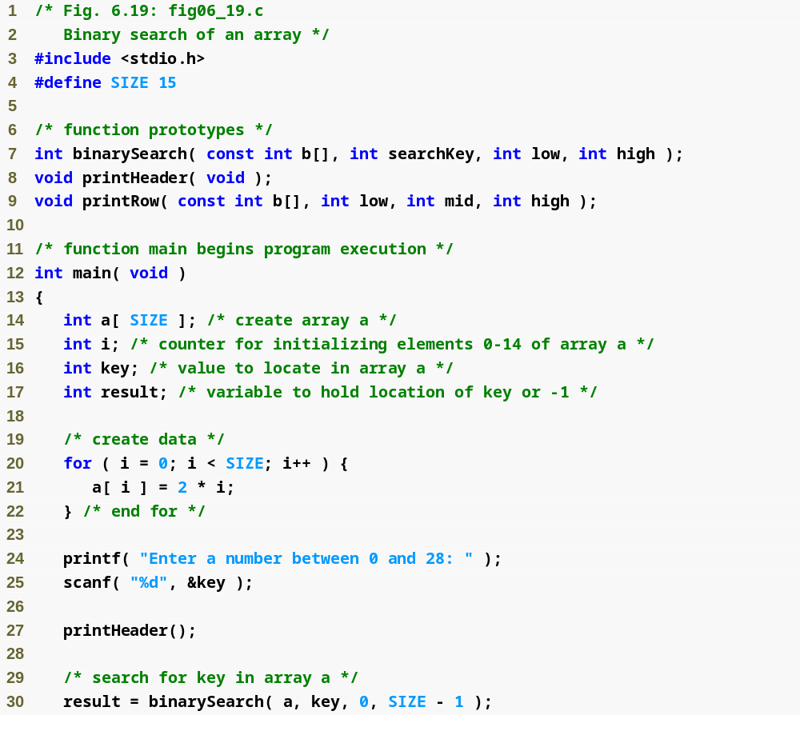
Outline
fig06_19.c
(1 of 6 )

Slide 33
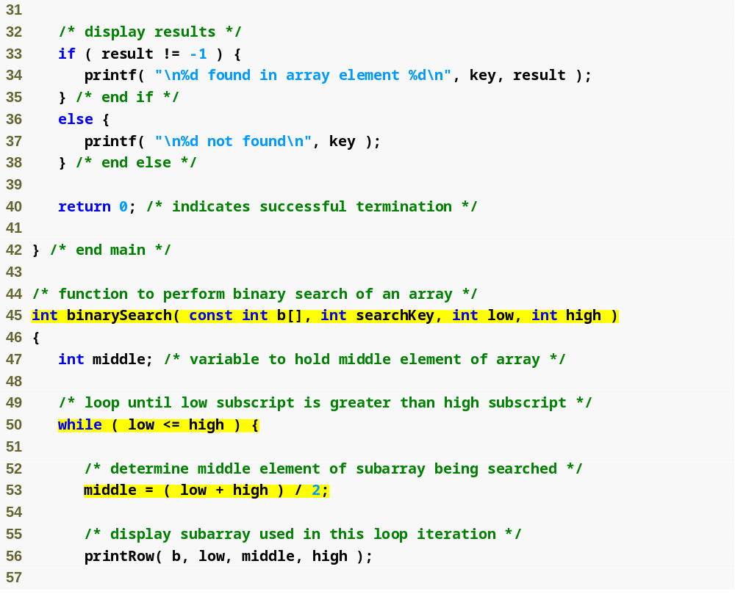
Outline
fig06_19.c
(2 of 6 )

Slide 34
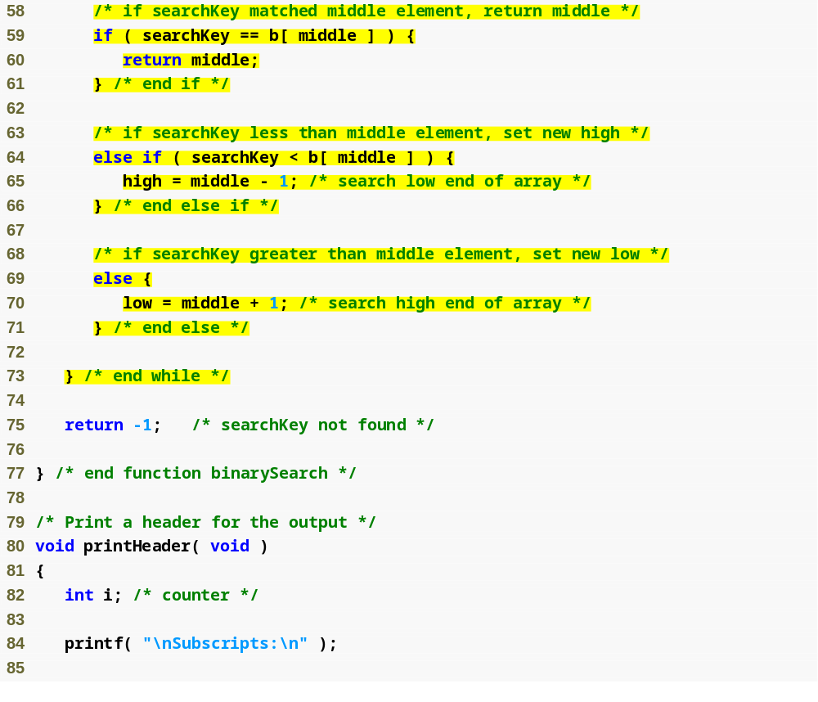
Outline
If value is found, return its index
fig06_19.c
(3 of 6 )
If value is too high, search the left half of array
If value is too low, search the right half of array

Slide 35
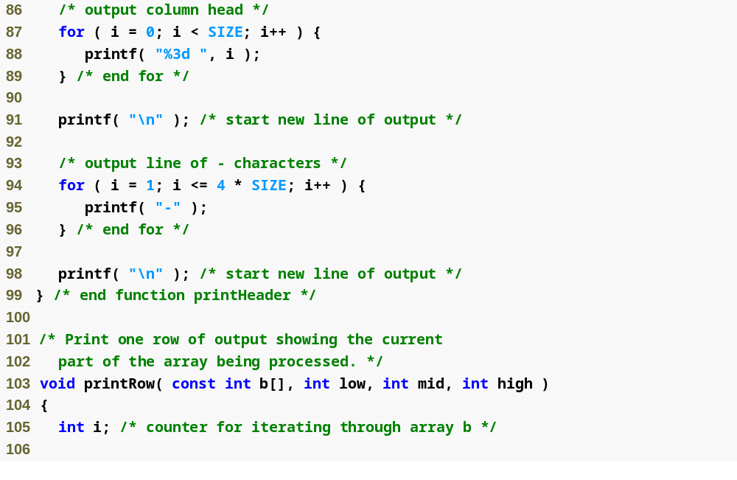
Outline
fig06_19.c
(4 of 6 )

Slide 36
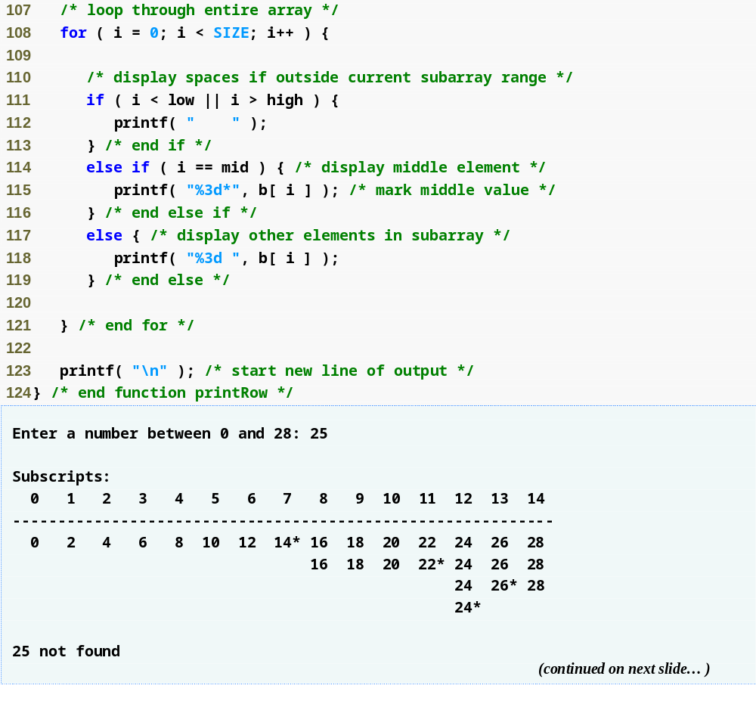
Outline
fig06_19.c
(5 of 6 )

Slide 37
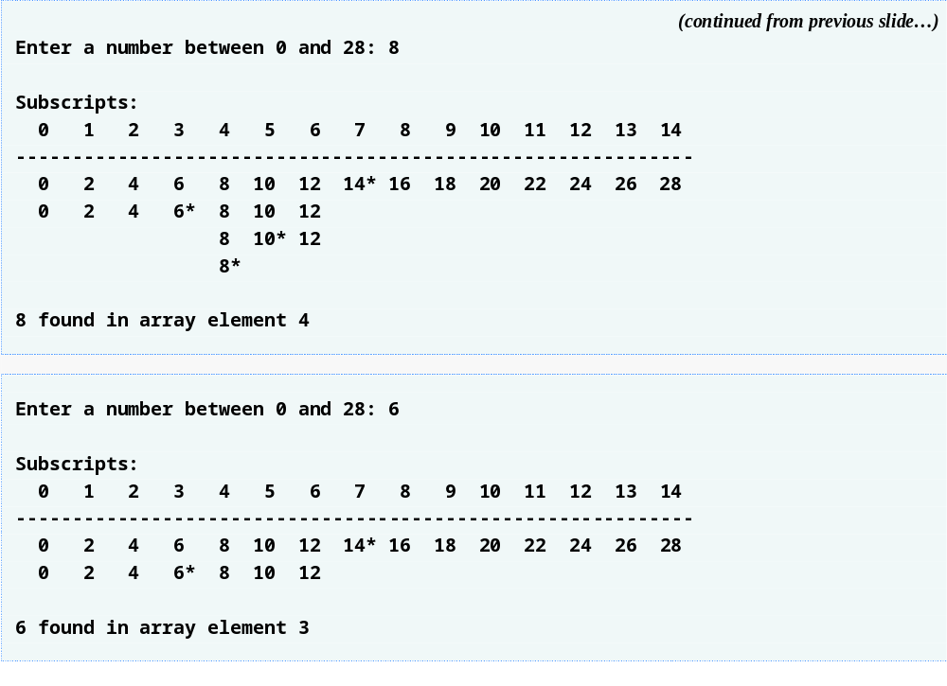
Outline
fig06_19.c
(6 of 6 )

